Slide 1
IBM Data Science Capstone Project
Predicting Accident Severity in Seattle based on historical data

Slide 2
Background
Car accidents are a common occurrence in US roads, with Washington state reporting 111,599 cases in 2019
Seattle city accounted for about 10% of the cases in Washington state
Prediction of severity of car accidents along with a detailed data analysis can be useful for policymakers to find a solution to this problem

Slide 3
Data Description
Data Source : Sample data provided as part of the IBM Data Science Coursera course.
The .csv file contains 194,673 collision records for Seattle. There are 38 columns covering different aspects of the data.
Metadata provides data set summary along with the attribute information and other useful details.
Objective : Predict severity of car accidents and therefore we are going to predict “SEVERITYCODE” (target variable) based on other variables

Slide 4
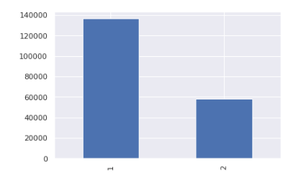
Data Visualization – Severity Code
A larger number of the car accidents result in property damage only. (1 = property damage, 2 = injury).

Slide 5
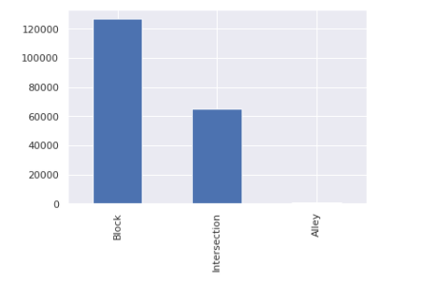
Data Visualization – Collision Address Type
A larger number of the car accidents happen at Blocks

Slide 6
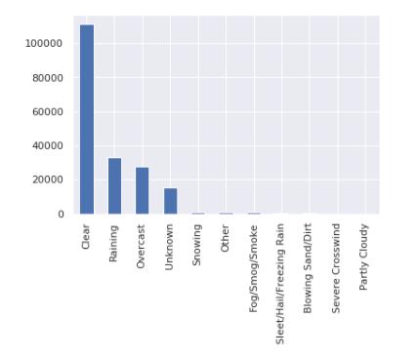
Data Visualization – Weather conditions
A larger number of the car accidents happen during clear weather

Slide 7
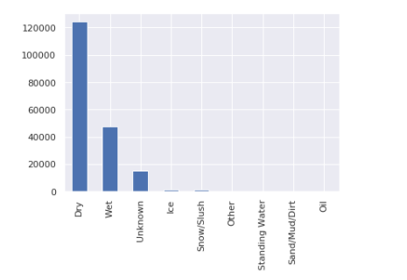
Data Visualization – Road conditions
A larger number of the car accidents happen during dry road conditions

Slide 8
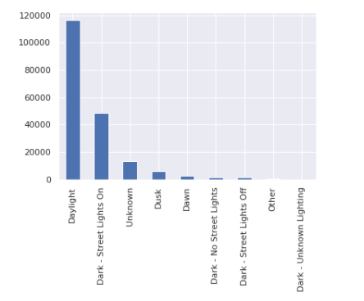
Data Visualization – Light conditions
A larger number of the car accidents happen during daylight

Slide 9
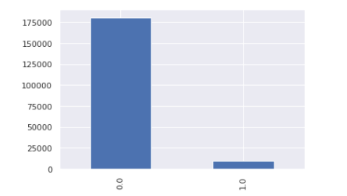
Data Visualization – Alcohol influence
A larger number of the car accidents happen under lack of alcohol influence (0 = No, 1 = Yes)

Slide 10
Data Cleaning
In its original form, this data is not fit for analysis because it has many columns which will not be used for this model.
Also, most of the features are of type object, when they should be numerical type.
Steps taken to assign numerical values to features and to remove data points missing values

Slide 11
Balancing the dataset
The target variable SEVERITYCODE is not perfectly balanced. The severitycode in class 1 is more than twice the size of class 2 after removing others and unknown.
This is fixed by downsampling the majority class.
Post balancing, we have 55,616 datapoints for each SEVERITYCODE

Slide 12
Methodology
We will use the following models:
K-Nearest Neighbor (KNN)
K nearest neighbors is a simple algorithm that stores all available cases and classifies new cases based on a similarity measure (e.g., distance functions). KNN will help us predict the severity code of an outcome by finding the most similar to data point within k distance.
Decision Tree
A decision tree model gives us a layout of all possible outcomes so we can fully analyze the consequences of a decision. In this context, The decision tree will observe all possible outcomes of different weather conditions, light conditions, road conditions and alcohol influence.
Logistic Regression
Because our dataset only provides us with two severity code outcomes, our model will only predict one of those two classes. This makes our data binary, which is perfect to use with logistic regression.

Slide 13
Initializing the model
We initialize the model through the following steps:
Define X (feature set) and y (dependent/target variable)
Feature includes ADDRTYPE, ROADCOND,LIGHTCOND,WEATHER,UNDERINFL
SEVERITYCODE is the dependent variable
Dataset is normalized using Scalar transformation
Data is split between training set (80%) and test set (20%)

Slide 14
Model Results Summary
K-Nearest Neighbor (KNN)
Accuracy of 0.54 with best accuracy at k = 5
Decision Tree
Accuracy of 0.59
Logistic Regression
Accuracy of 0.59

Slide 15
Conclusion
K-Nearest Neighbor (KNN)
Accuracy of 0.54 with best accuracy at k = 5
Decision Tree
Accuracy of 0.59
Logistic Regression
Accuracy of 0.59

Slide 16
Conclusion
Based on the historical data, we can conclude that the factors light condition, road condition, alcohol influence, collision address type and weather conditions have some impact on whether or not car accident could result in property damage (class 1) or injury (class 2)
Logistic Regression and Decision Tree seem to provide more accurate prediction.

